Slide 1


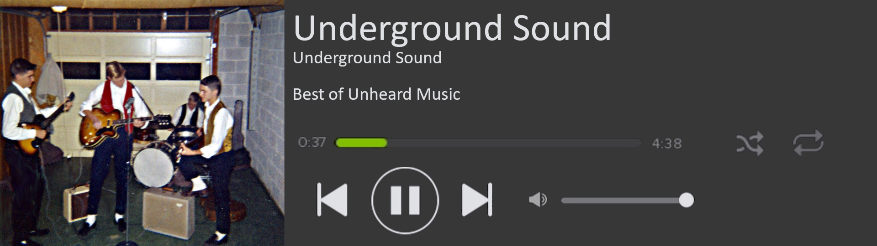

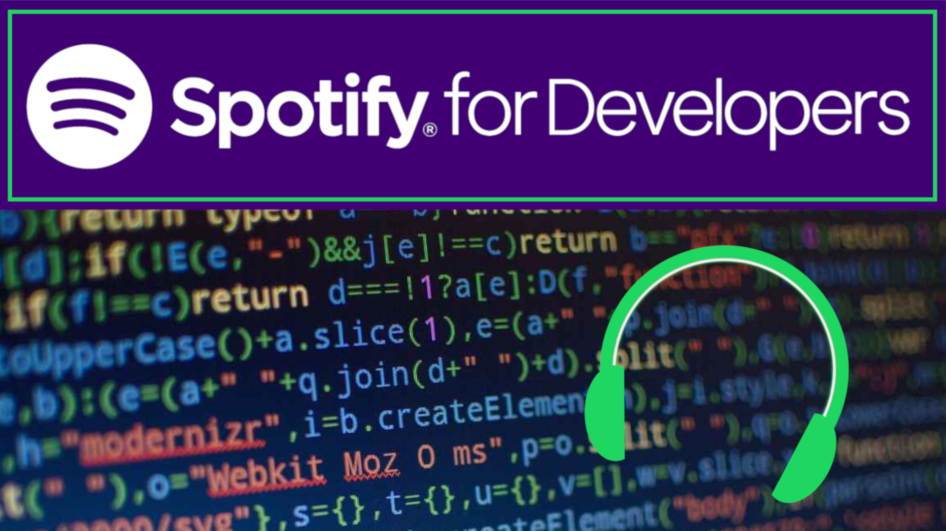



Underground Sound: Discovering New and Unique Music
Avery Anjard, John Reddick, Zach McCauley, Kristian Trabosci, Cameron Turner • UNIVERSITY OF NORTH FLORIDA, COLLEGE, JACKSONVILLE, FLORIDA
INTRODUCTION
DESIGN AND DEVELOPMENT
HOSTING AND BACKEND
When we use music streaming services, we often get recommended music based on what we listen to. These recommendations come from the choices of similar users and the popularity trends of music within the same genre, but often misses niche or little-known
For our project, we needed some way to recommend songs and/or artists to users. We wound ideally do this with an established and labeled database of music, which Spotify mercifully has and lets us access in its entirety. The Spotify API allows us to query any data in Spotify’s music database and make decisions based on the traits of media.
Through the use of this API via SpotiPy- a Python-centric method of querying internal data- we were able to take advantage of the massive flexibility of Python for our backend. When we need information, we search through the song/artist database by genre to get the data we need.
Early on, we considered using React with our website. React is a versatile tool for developing formal and functional websites. If we continue development of our project past this semester, then we may consider switching to react over python. React loads quickly and is simple to use, but we decided against using it because the initial set-up can be kind of a hassle. The amount of documentation and fiddling with react can be time consuming, so for now we are deciding to use a slightly more flexible (albeit slightly more clunky) frontend integration with the Flask library in Python.
We are using the free-tier of amazon web-services to host our server. This means we will not have to worry about maintain our own server, and the plug and play nature makes this very convenient.
The way our main Python program will communicate with our front end will be handled almost entirely by the Flask Python package. Flask allows us to directly interact with our HTML elements (namely retrieve and set their content,) from the comfort of a Python script, minimizing the need to use substantial amounts of JavaScript or PHP.
artists and songs. This is the basis of the Underground Sound project- to find uncommon, niche, or otherwise unknown songs that are related to the music we already enjoy!
SOFTWARE ARCHITECTURE
Our application aims to bring out great music that few people would otherwise ever hear!
USER INTERACTION
Our application is segmented into several parts. First, we have the actual driving force behind the recommendation algorithm- our Python program that makes calls to the Spotify API. We also have our front end, a static website that we will host through Amazon Web Services, which will actually interact with end users. Once a user interacts with the website, that data will be analyzed by our Python program and all necessary calls to the Spotify API will be made. Songs will be selected, their data will be retrieved, and that information will be presented to the end user.
The front end of our project will be a simple static website that allows users to pick genres from a large list. The user will be prompted to select up to five genres (and at least one,) which will be used by the main program and algorithm to determine a selection of songs the user might enjoy. When those songs are determined, the website will display information about these songs- the name, artist, genre, duration, and album cover art if applicable- and offer the user links to each song in the main Spotify app.

